Slide 1


YOUR ONE STOP DESTINATION FOR AI & ROBOTICS

Slide 2
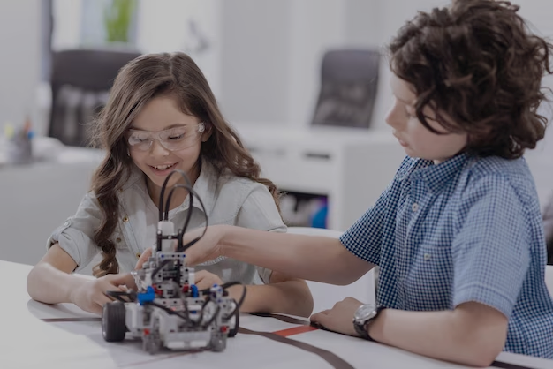

You will learn from us
Coding
Fundamentals of AI
Hands on IoT & Robotics
Maths
Effective Communication Skills
Ethical Awareness

Slide 3

Unleash Your Inner Genius with Our Math Hacks
Vedic Mathematics
Quick Calculation Tricks
Enhanced Number Awareness
Applying Maths to Real World Problems
Visualizing Mathematical Concepts
Focus & Confidence Boost

Slide 4
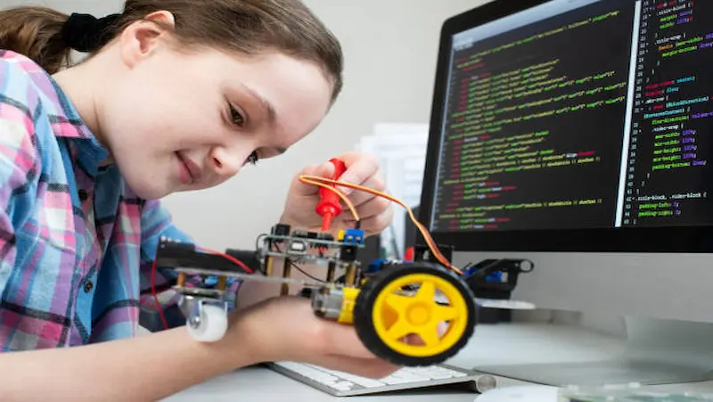
Be a Tech Wiz with Our IoT & Robotics Courses
STEM Concepts
Creativity
Problem Solving
Programming & Logic
Industrial Flavor
Internet & Cloud

Slide 5
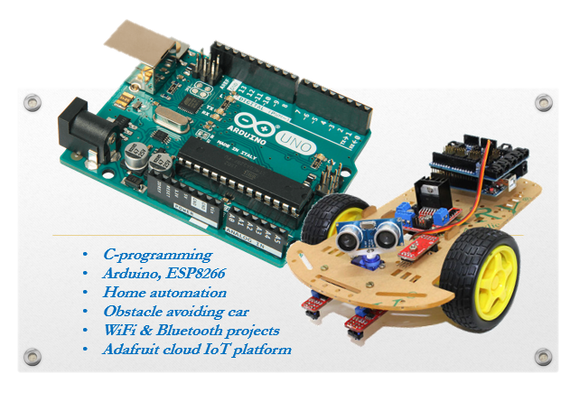
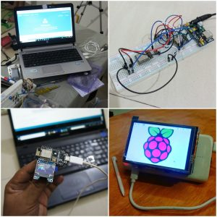

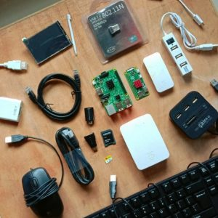
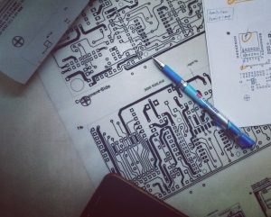

Slide 6
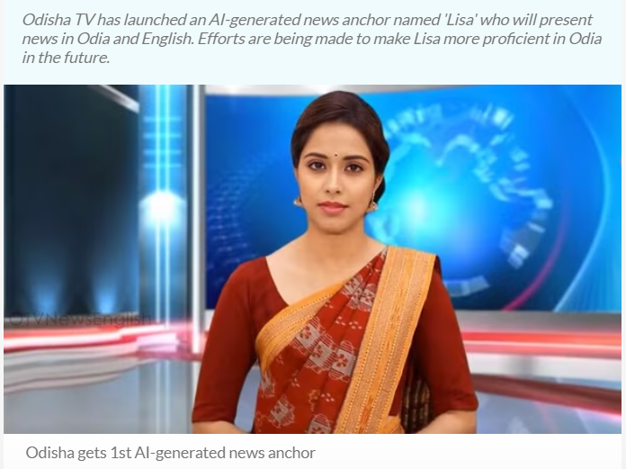

Slide 7
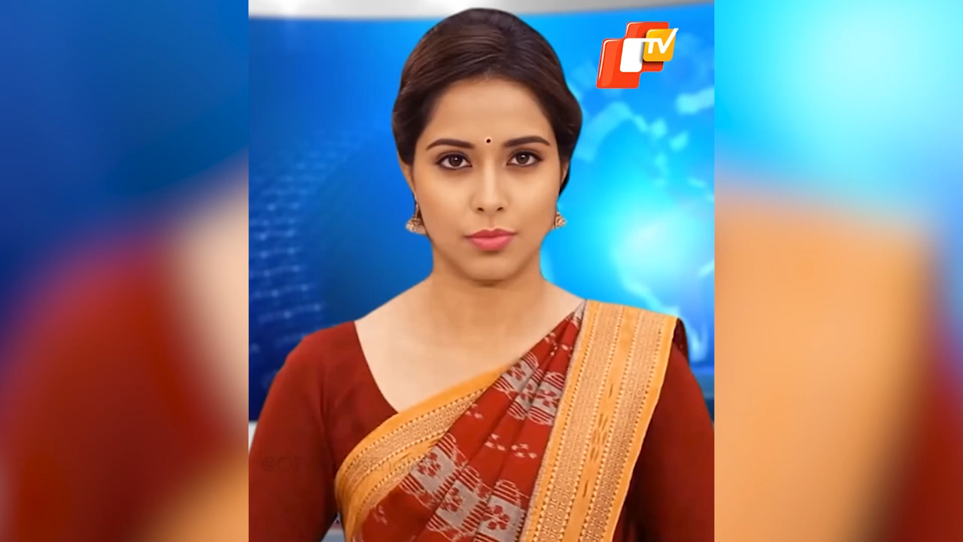
Lisa

Slide 8

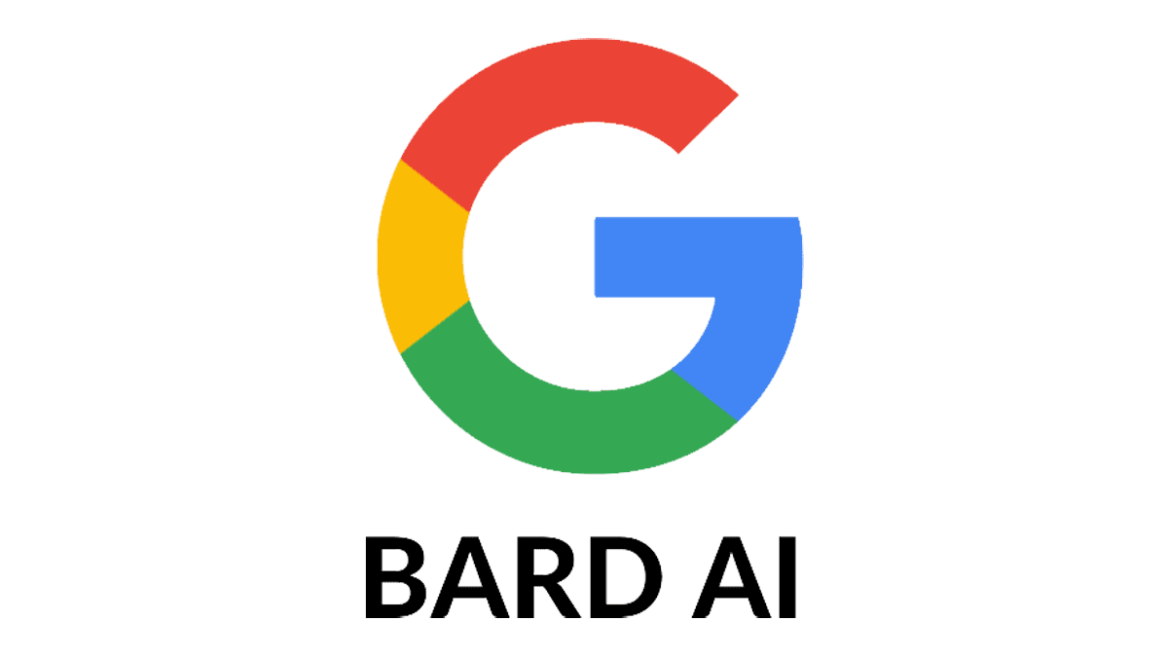



Unveil AI with Anodiam
ChatGPT is just the tip of an iceberg!
Dive deeper with us & be the next AI expert
Creativity
Machine Learning
Mathematics
Neural Networks
Statistics
Deep Learning
Coding
Data Science

Slide 9








AI PROFESSIONALS ARE THE MOST SOUGHT AFTER WORLDWIDE

Slide 10

Become A Speech Maestro with Our Grooming Sessions
Confidence Boost
Social Integrity
Empathy
Teamwork
Leadership
Interview & Presentation Skills
Corporate Etiquettes

Slide 11
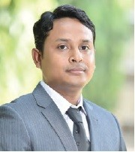
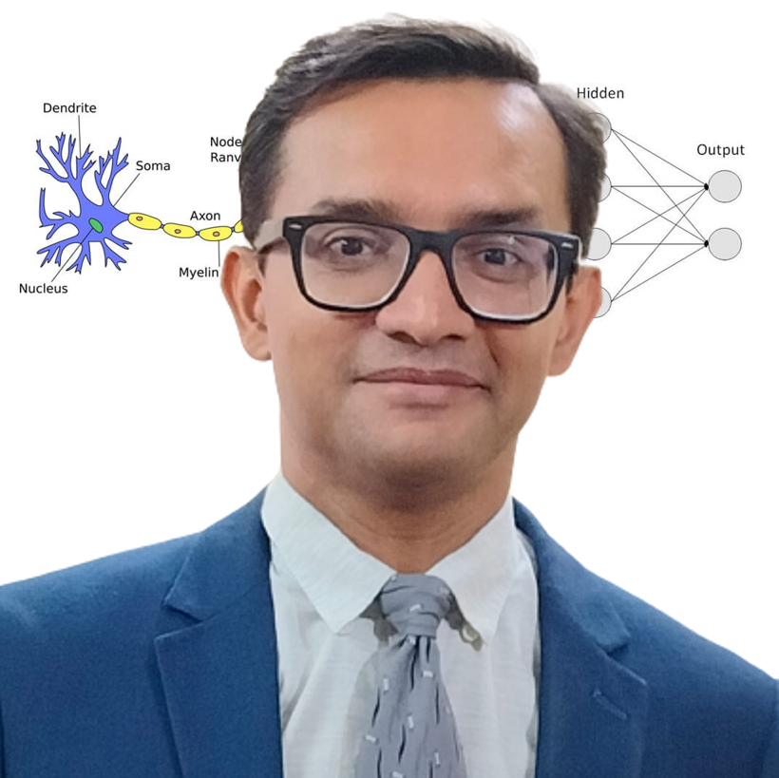
Thanks to Our Speakers
Bappaditya Debsingha, IoT Product Manager, TCS, 18 years of global experience in Robotics
Anirban Chakrabarty, C.E.O. of Anodiam, 24 years of experience in IT, Corporate grooming & AI

